Slide 1
Development of the Theory of Continental Drift

Slide 2
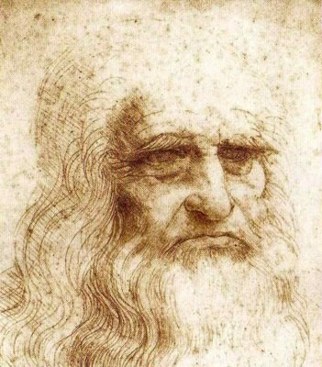
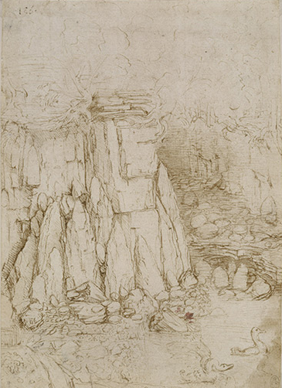
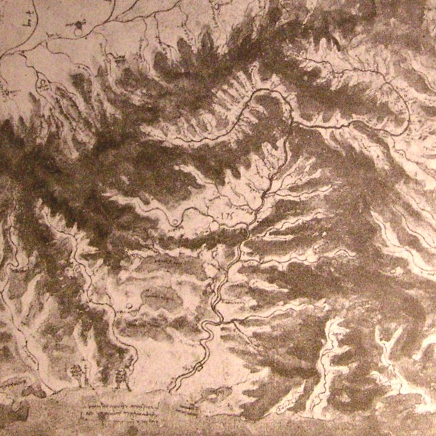
Leonardo
da Vinci
1452 – 1519
Notes:
Often cited as a contributor to the theory of continental drift, I could not find any direct quotes of Leonardo’s that suggest lateral continental motion. Nonetheless, he did have a keen interest in geology and correctly identified flowing water (not divine creation) as the major sculptor of the earths surface and attributed the presence of marine fossils on land to the uplift of ancient sea floor.

Slide 3
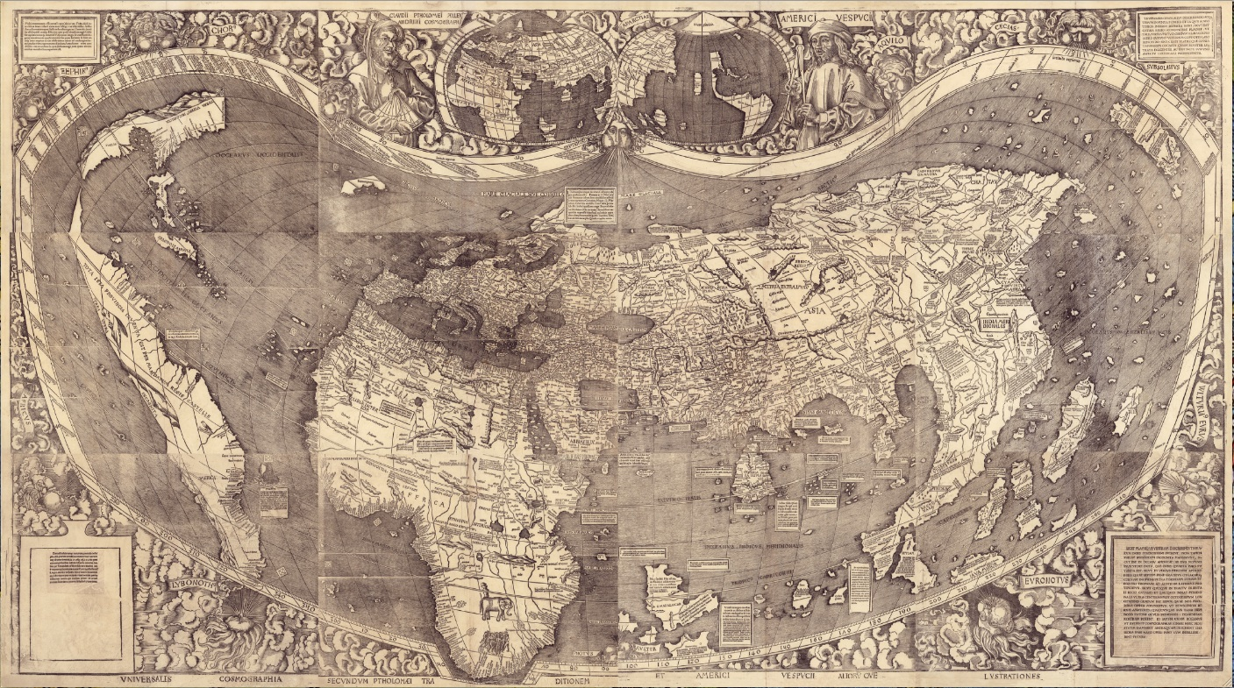
1507 ‘Waldseemuller Map”
First map of the entire earth
Notes:
He also lived when the first maps of the new world where made, but I could find no direct reference that he noted the similarity of Atlantic coastlines.

Slide 4
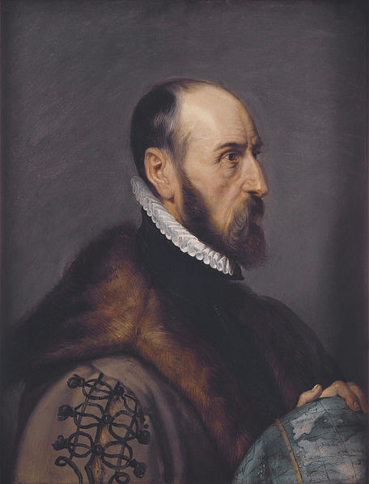
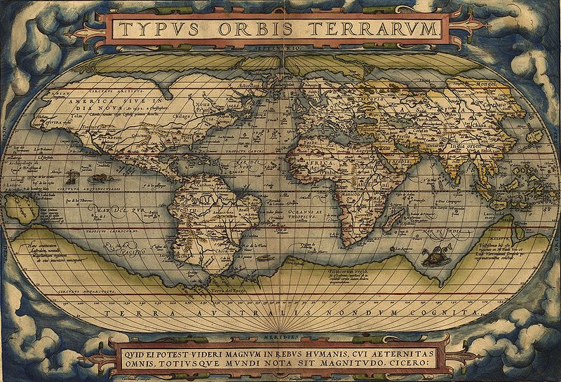
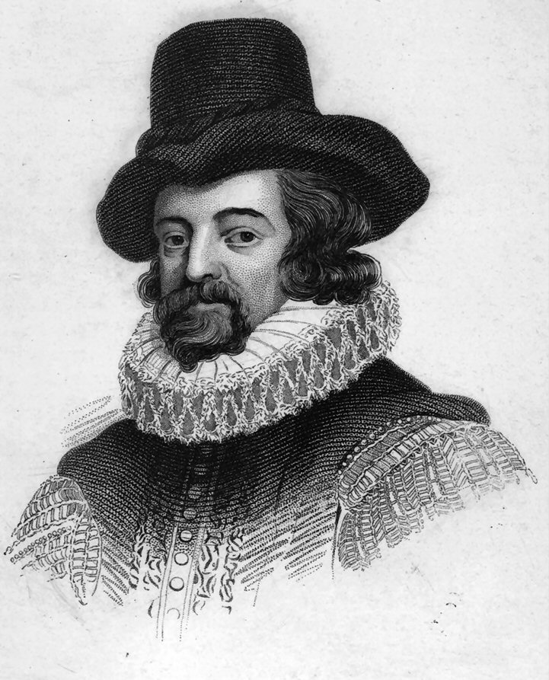
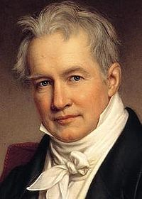
Abraham Ortelius - Flemish cartographer
1596 – “torn away from Europe and Africa ... by earthquakes and floods”
1666-1801 various “Noachian” naturalists
Sir Francis Bacon English statesman & philosopher
1620 “similarity of African and S. American shorelines… ”
Alexander von Humboldt German naturalist
1801 “lands bordering the Atlantic Ocean had once been joined… …disconnected by erosion”
Notes:
However, the outlines of the continents bordering the Atlantic Ocean are so similar that many probably noticed the correspondence, and some might have drawn the conclusion that the lands on both sides were once joined together. The earliest reference to this peculiar geographic feature was made by the English philosopher Francis Bacon. In his Novum Organum (1620), Bacon pointed out the correspondence but did not go beyond that. Such was also the extent of the contribution of the great French naturalist Georges-Louis Leclerc, Count du Buffon, a century later. Neither can Franois Paget qualify as a forerunner of continental drift theorists: even though he stated in 1666 that an undivided continent existed before Noah's flood, he explained the creation of the Atlantic Ocean by having part of that continent sink into the sea.

Slide 5
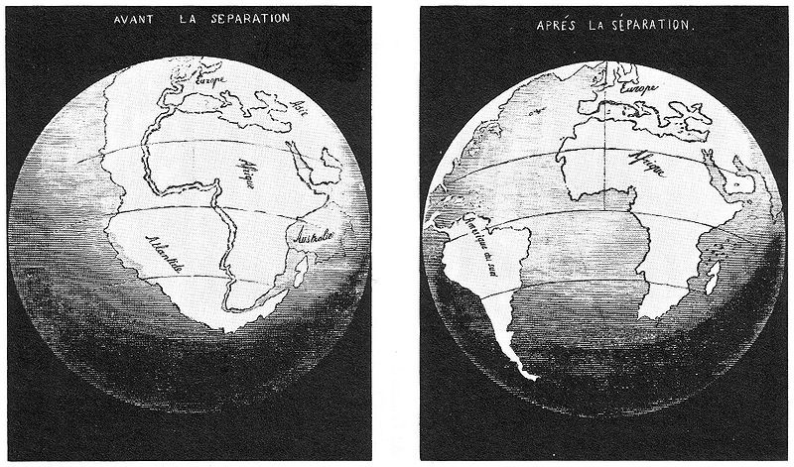
Antonio Snider-Pellegrini
French scientist
1858 “ascribed the biblical flood to the former existence of a single continent that was torn apart to restore the balance of a lopsided Earth”
Fossils
Notes:
One of the earliest specific references to continental drift is in the 1858 book Creation and Its Mysteries Revealed by Antonio Snider-Pellegrini. He suggested that all of the continents were linked together during the Pennsylvanian Period and later split apart. He based his conclusions on the similarities between plant fossils in the Pennsylvanian-aged coal beds of Europe and North America, and attributed the separation of the continents to the biblical deluge. As noted by Snider-Pellegrini and Wegener, the locations of certain fossil plants and animals on present-day, widely separated continents would form definite patterns (shown by the bands of colors), if the continents are rejoined.
The first credible proponent of continental drift was Antonio Snider-Pellegrini, a belated advocate of catastrophism who, in 1858, ascribed the biblical flood to the former existence of a single continent that was torn apart to restore the balance of a lopsided Earth.

Slide 6
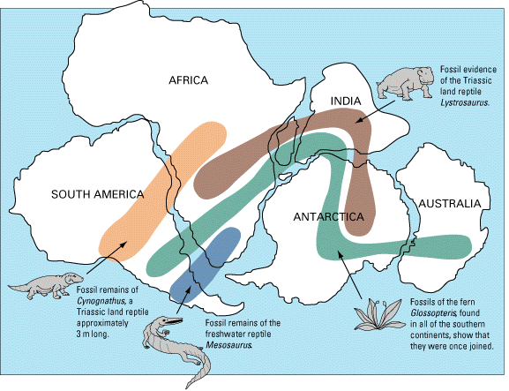
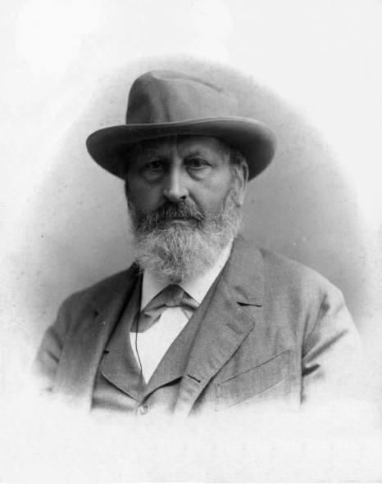
Contraction Theory
Gondwana
Edward Suess - Austrian geologist
1885 “contraction of Gondwanaland”
Notes:
During the late nineteenth century, the Austrian geologist Edward Suess noted the similarities between the Late Paleozoic plant fossils of India, Australia, Africa, Antarctica, and South America as well as evidence of glaciating in the rock sequence of these southern continents. In 1885 he proposed the name Gondwanaland (or Gondwana as we will use here) for a supercontinent composed of these southern landmasses. Gondwana is a province in east-central India where evidence exists for extensive glaciation as well as abundant fossils of the Glossopteris flora, an association of Late Paleozoic plants found only in India and the Southern Hemisphere continents. Suess thought the distribution of plant fossils and glacial deposits was a consequence of extensive land bridges that once connected the continents and later sank beneath the ocean.

Slide 7
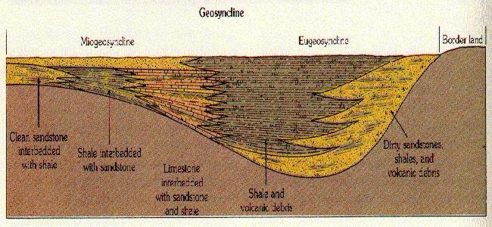
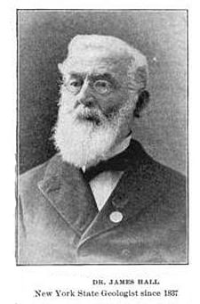
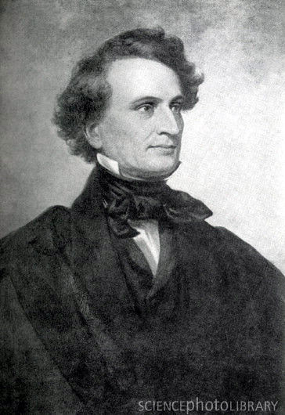
Contraction / Permanence / Geosynclinal Theory
American Geologists
James Dwight Dana (1813-1895) Cooling forms continents first then oceans. Stress greatest at boundaries, causing subsidence.
James Hall (1811-1889) Sedimentation causes subsidence (geosynclines).
Notes:
In North America, a different version of contraction theory was developed by James Dwight Dana (1813-
1895). Dana suggested that the Earth’s continents had formed first, when minerals with relatively low
fusion temperatures such as quartz and feldspar had solidified. Then the globe continued to cool and
contract, until the high temperature minerals such as olivine and pyroxene finally solidified: on the moon,
to form the lunar craters, on Earth, to form the ocean basins. As contraction continued after the Earth was
solid, it induced surface deformation. The greatest pressure was experienced at the boundaries between the
oceanic and continental blocks, explaining the concentration of mountains along continental margins.
Because continents and oceans were viewed as globally permanent features, Dana’s account came to be
known as permanence theory.
In North America, permanence was linked to the theory of geosynclines, developed by Dana and James
Hall (1811-1989), State Paleontologist of New York and the first President of the Geological Society of
America (1889). Hall noted that the Appalachian mountains mostly consisted of folded sequences of
shallow-water sedimentary rocks, thousands of feet thick. How did thick sequences of shallow-water
form? How were they folded and uplifted into mountains? Hall suggested that materials eroded off the
continents accumulated in the adjacent marginal basins, causing the basin to subside. Subsidence allowed
more sediments to accumulate, causing more subsidence, until finally the weight of the pile caused the
sediments to be heated, lithified, and then uplifted into mountains. Dana modified Hall’s view by arguing
that thick sedimentary piles were not the cause of subsidence but the result of it. Either way the theory
provided a concise explanation of how thick sequences of shallow-water rocks could form, but was vague
on the question of how they were transformed into mountain belts.

Slide 8
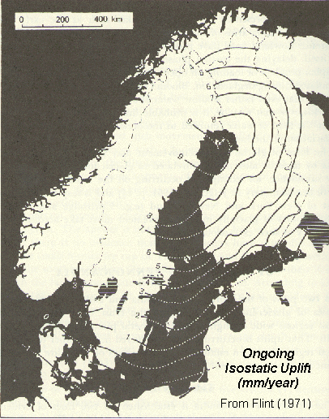
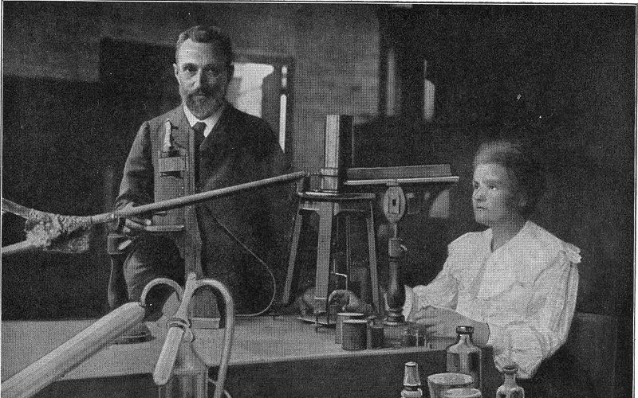
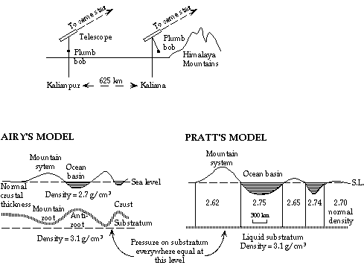
Contraction Abandoned
Field mapping in the Swiss Alps and the North American Appalachians demonstrated hundreds of miles of shortening of strata - requiring impossibly huge amounts of terrestrial contraction to explain.
Pierre and Marie Currie
Discovery of radioactivity provides an internal source of heat.
Isostasy – crust buoyantly supported
Notes:
In the early twentieth century, contraction theory was refuted by three independent lines of evidence. First,
field mapping in the Swiss Alps and the North American Appalachians demonstrated hundreds of miles of
shortening of strata. This would require impossibly huge amounts of terrestrial contraction to explain.
Second, geodesists studying the problem of surface gravitational effects showed that the surface mass
associated with mountains was counterbalanced by subsurface mass deficit. Mountains were held aloft not
by their internal strength, but by floating—a concept called isostasy. Contra Suess, continents and oceans
were not interchangeable. Third, physicists discovered radiogenic heat, which refuted the basis of
contraction theory.

Slide 9
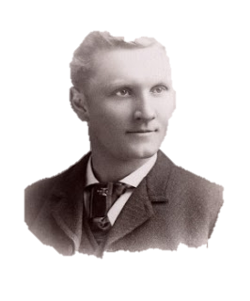
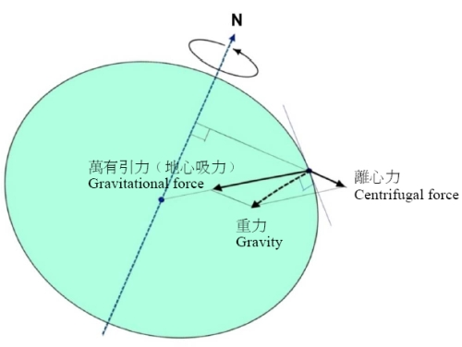
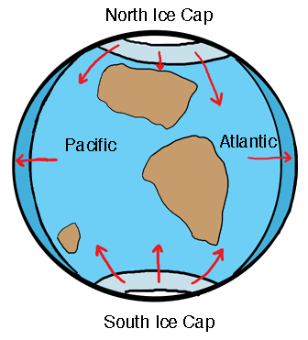
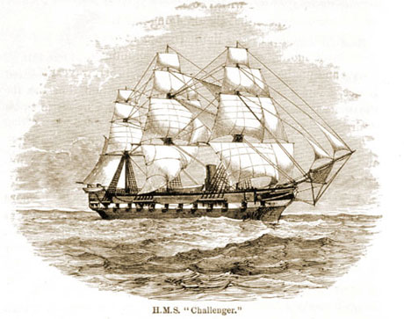
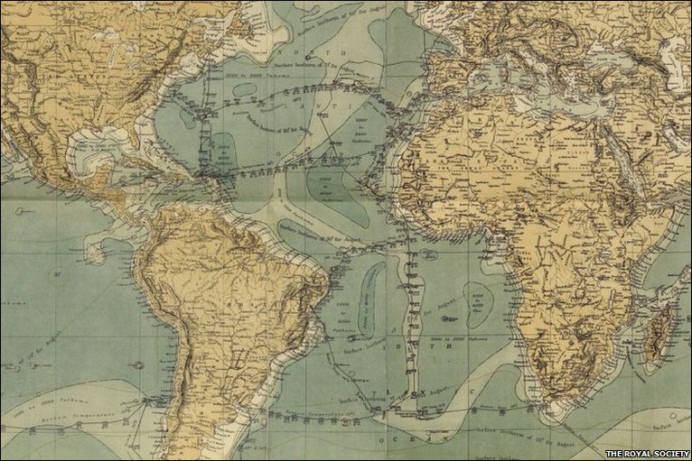
Centrifugal / Pole “Flight” / Tidal Theories
Frank B. Taylor
American geologist
1910 Pamphlet:
mountains from form lateral continent motion
due to centrifugal/tidal forces
suggested that Mid-Atlantic Ridge marks the break-up site
1871-1876
Notes:
With contraction no longer axiomatic, earth scientists were motivated to search for
other driving forces of deformation. Many did; Alfred Wegener (1880-1930) is the most significant, for his
theory was the most widely discussed.
More recent and much more sophisticated was the work of the American geologist Frank Taylor, who, disdaining the then-prevailing contraction model of mountain building, postulated in 1908 that the arcuate mountain belts of Asia and Europe resulted from the equatorward creep of the continents. His analysis of tectonic features foreshadowed in many ways modern thought regarding plate collisions, and he anticipated Wegener's publications by only a few years. Curiously, however, his work instantly sank into oblivion.
In 1910, the American geologist Frank B. Taylor published a pamphlet presenting his own theory of continental drift. He explained the formation of mountain ranges as a result of the lateral movement of continents. He also envisioned the present-day continents as part of larger polar continents that eventually broke apart and migrated toward the equator after the Earth's rotation supposedly slowed due to gigantic tidal forces. According to Taylor, these tidal forces were generated when the Earth captured the moon about 100 million years ago Although we now know that Taylor's mechanism is incorrect, one of his most significant contributions was his suggestion that the Mid-Atlantic Ridge, discovered by the British H.M.S. Challenger expeditions of 1872-1876, might mark the site along which an ancient continent broke apart to form the present-day Atlantic Ocean.

Slide 10
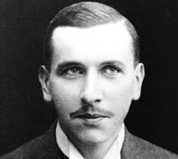
"A conviction of the fundamental soundness of the idea took root in my mind."
Alfred Wegener 1880- 1930
Meteorologist
Climatologist
Astronomer
Geologist
Notes:
Although Taylor’s ideas drifted into obscurity, the notion of continental drift would be brought to the forefront of scientific debate by German meteorologist, climatologist, astronomer and geologist Alfred Wegener. His interdisciplinary background was uniquely suited to the problem and Wagener had the drive and work ethic to eventually publish a book on his theory.

Slide 11
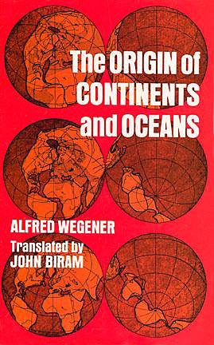
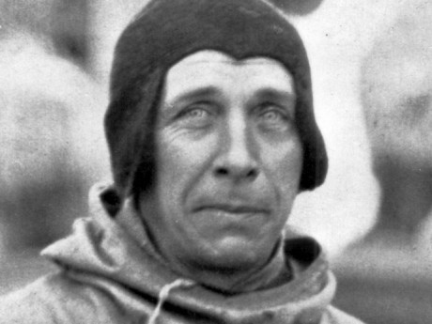
1915
Notes:
In it he summarized and added to the evidence of his predecessors and put forward original ideas as well.

Slide 12
Wegener’s Evidence:
Fit of continents * improves with continental shelves
Notes:
Wegener was one of the first to point out that the fit of the continents improves with the inclusion of the continental shelves…

Slide 13
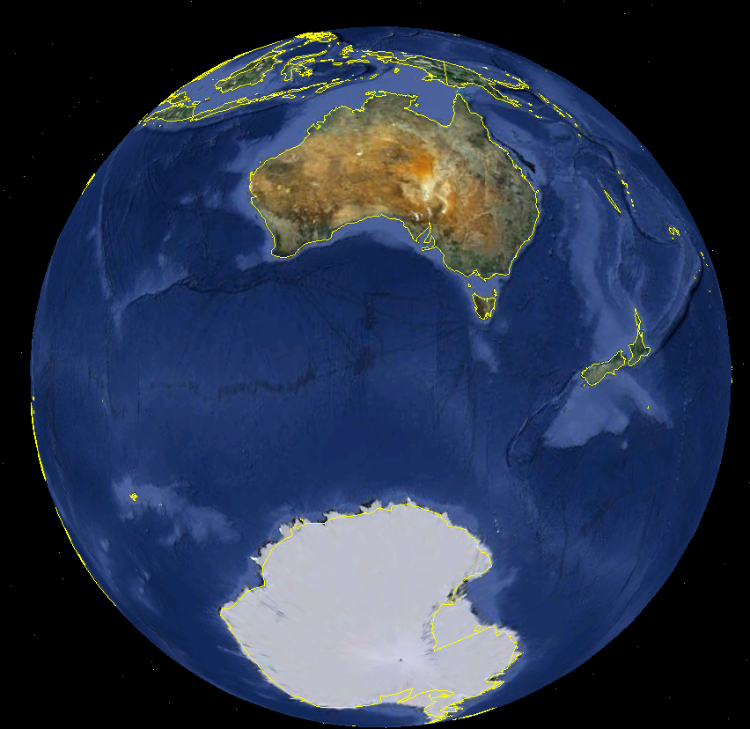
Wegener’s Evidence:
Fit of continents * improves with continental shelves * all continents fit
Notes:
…and that the Antarctica fits nicely into the great Australian bight.

Slide 14
Wegener’s Evidence:
Fit of continents * improves with continental shelves * all continents fit (PANGAEA)
Notes:
He was the first to propose that all the continents could be assembled into a supercontinent he named Pangaea.

Slide 15
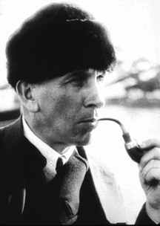
Wegener’s Evidence:
Fit of continents * improves with continental shelves * all continents fit
Same fossils on different continents
Notes:
While at Marburg, in the autumn of 1911, Wegener was browsing in the university library when he came across a scientific paper that listed fossils of identical plants and animals found on opposite sides of the Atlantic. Intrigued by this information, Wegener began to look for, and find, more cases of similar organisms separated by great oceans.

Slide 16
Figure 15.5
Notes:
Orthodox science at the time explained such cases by postulating that land bridges, now sunken, had once connected far-flung continents. But Wegener noticed the close fit between the coastlines of Africa and South America. Might the similarities among organisms be due, not to land bridges, but to the continents having been joined together at one time? As he later wrote: "A conviction of the fundamental soundness of the idea took root in my mind."

Slide 17
Wegener’s Evidence:
Fit of continents * improves with continental shelves * all continents fit
Same fossils on different continents
Similar rocks on different continents

Slide 18
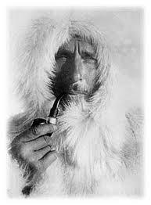
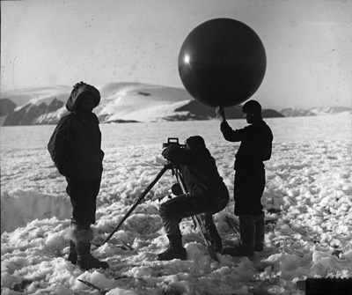
Wegener’s Evidence:
Fit of continents * improves with continental shelves * all continents fit
Same fossils on different continents
Similar rocks on different continents
Ancient climate patterns don’t match present

Slide 19
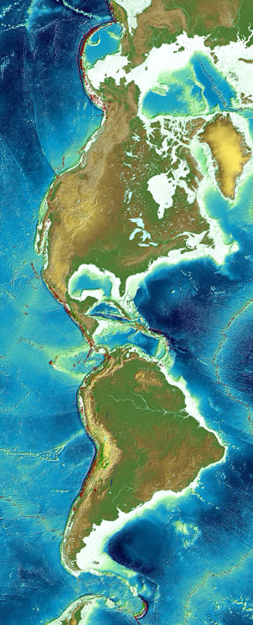
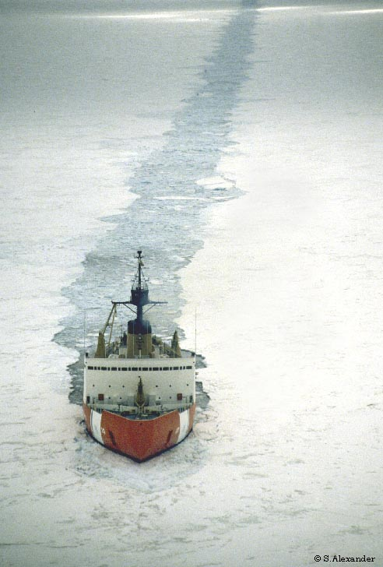
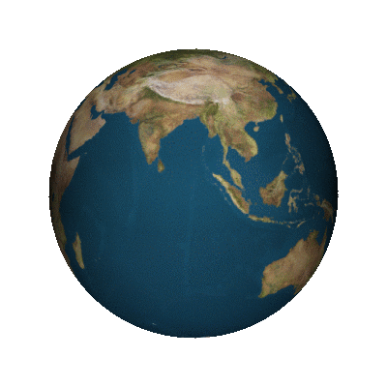
Wegener’s Mechanism:
Centrifugal and tidal forces cause the continents to “plow” through ocean crust
The Problem:
Seismic waves indicate a rigid mantle - Not enough energy
How could ocean crust be soft enough for continental drift yet so hard it crushed the leading edge of continents?

Slide 20
Notes:
Wagener’s lack of a plausible mechanism for continental drift did not help his credibility, but scientific prejudices contributed greatly to his lack of acceptance in America.

Slide 21
Wegener
Notes:
To American eyes Wegener’s work was bad science: It put the theory first and then sought evidence for it. It settled too quickly on a single interpretive framework. It was too large, too unifying, too ambitious. In short, it was seen as autocratic.

Slide 22
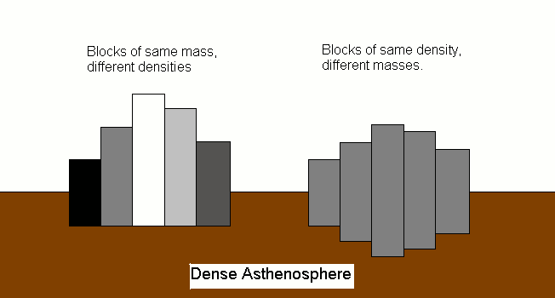
Pratt Isostasy
Airy Isostasy
Notes:
Continental drift seemed to refute Pratt isostasy, which had worked for Americans
so well. Rather then reject Pratt isostasy, they rejected continental drift.

Slide 23
UNDERMINED UNIFORMITARIANISM
Notes:
Third, Americans rejected continental drift because of the legacy of uniformitarianism. By the early
twentieth century, the methodological principle of using the present to interpret the past was deeply
entrenched in the practice of historical geology. Many believed this the only way to interpret the past, that
uniformitarianism made geology a science, for without it what proof was there that God hadn’t made the
Earth in seven days, fossils and all? Historical geologists routinely used faunal assemblages to make
inferences about climate zones, but according to drift theory, continents in tropical latitudes did not
necessarily have tropical faunas, because the reconfiguration of continents and oceans might change
matters altogether. Wegener’s theory raised the specter that the present was not the key to the past—that it
was just a moment in Earth history, no more or less characteristic than any other. This was not an idea
Americans were willing to accept.

Slide 24
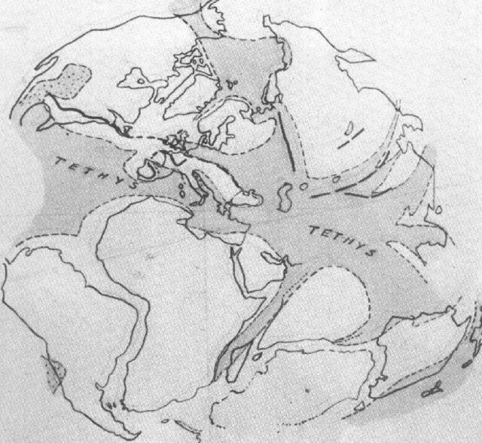
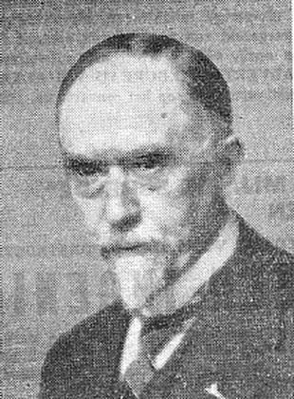
A TESTABLE HYPOTHESIS
Alexander duToit
S. African geologist
Geological Comparison of South America with South Africa (1927).
ROCK MATCHES
From “Our Wandering Continents” (1937)
Notes:
In 1923, he received a grant from the Carnegie Institution of Washington, and used this to travel to eastern South America to study the geology of Argentina, Paraguay and Brazil. As is apparent from his remarks in "Our Wandering Continents", he had not requested support for the expedition on a whim, but specifically to test his predictions of correspondences between the geology of the two continents. In the event he was able to demonstrate and follow the predicted continuation of specific features already documented in Southern Africa, into the continent of South America. Although that might perhaps seem less impressive to the layman, to the geologist this evidence was far more crushing than any arguable ex post facto matching of continental shelves.
In the light of his research du Toit published a review of the stratigraphic and radioisotope evidence from these regions that supported Alfred Wegener's ideas, A Geological Comparison of South America with South Africa (1927). His best-known publication, Our Wandering Continents (1937), expanded and improved this work, and, departing somewhat from Wegener, proposed two original supercontinents separated by the Tethys Ocean, a northern/equatorial Laurasia and a southern/polar Gondwanaland.
Read more: http://www.answers.com/topic/alexander-du-toit-1#ixzz1qfJkgSXS

Slide 25
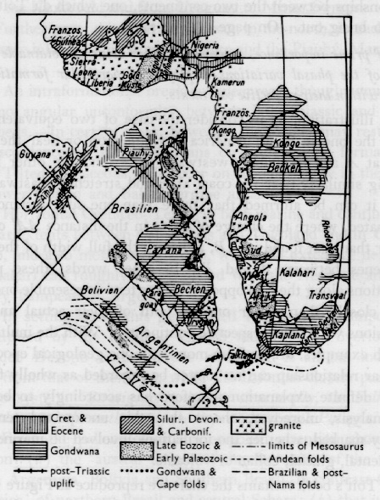
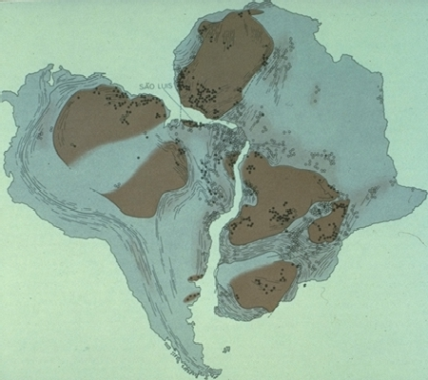
DU TOIT’S MAPS

Slide 26
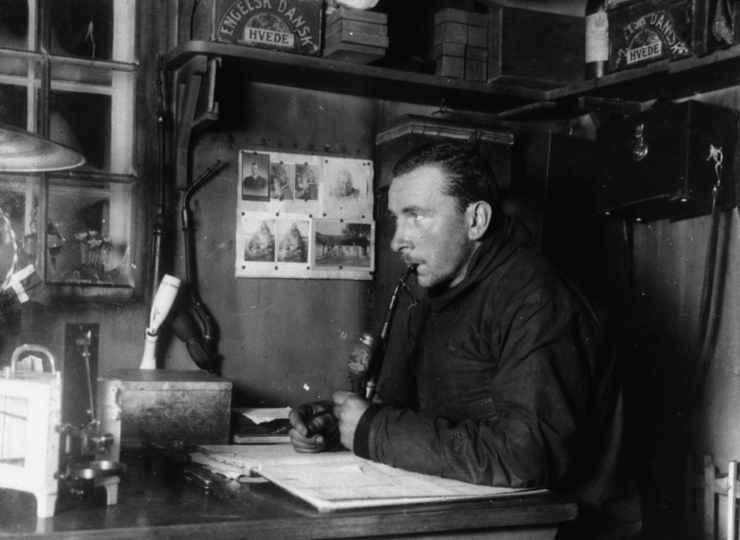

Slide 27
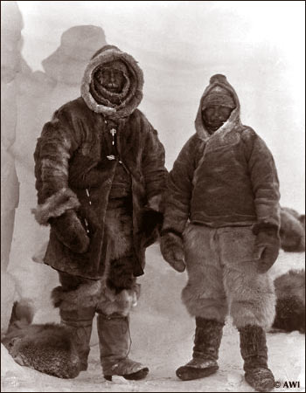
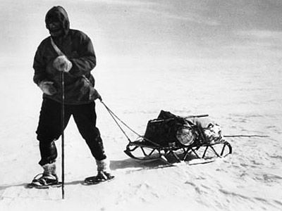
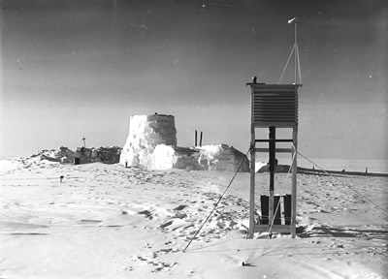
Wegener and Villumsen 1930 “Eismitte”
Notes:
Wegener's last expedition was to Greenland in 1930, to conduct the first 12-month monitoring of arctic weather. Wegener felt responsible for the expedition's success, as the German government had contributed $120,000 ($1.5 million in 2007 dollars) at a time when Germans were starving to death owing to post-war shortages. Success depended on enough provisions being transferred from West camp to Eismitte ("mid-ice") for two men to winter there and this was a factor in the decision that led to his death. Owing to a late thaw, the expedition was six weeks behind schedule and, as summer ended, the men at Eismitte sent a message that they had insufficient fuel and so would return on October 20.
On September 24, although the route markers were by now largely buried under snow, Wegener set out with thirteen Greenlanders and his meteorologist Fritz Loewe to supply the camp by dog sled. During the journey the temperature reached −60 °C (−76 °F) and Loewe's toes became so frostbitten they had to be amputated with a penknife without anesthetic. Twelve of the Greenlanders returned to West camp. On October 19, the remaining three members of the expedition reached Eismitte. There being only enough supplies for three at Eismitte, Wegener and Rasmus Villumsen took two dog sleds and made for West camp. They took no food for the dogs and killed them one by one to feed the rest until they could run only one sled. While Villumsen rode the sled, Wegener had to use skis. They never reached the camp.
Death
Six months later, on May 12, 1931, Wegener's body was found halfway between Eismitte and West camp. It had been buried (by Villumsen) with great care and a pair of skis marked the grave site. Wegener had been fifty years of age and a heavy smoker and it was believed that he had died of heart failure brought on by overexertion. His body was reburied in the same spot by the team that found him and the grave was marked with a large cross. After burying Wegener, Villumsen had resumed his journey to West camp but was never seen again. He was twenty three when he died and it is estimated that this body now lies under more than 100 metres (330 ft) of accumulated ice and snow.

Slide 28
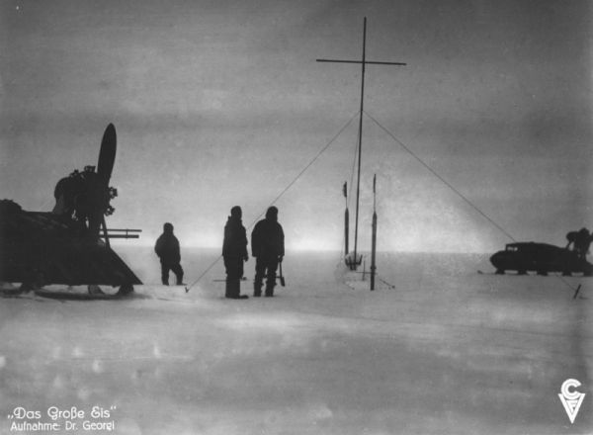

Slide 29
What did we learn?
Science progresses from observations to explanations - not vice versa. Using science to verify belief introduces personal bias that can ignore observations contrary to one’s beliefs and slow the development of valid theories.
The best ideas are not necessarily the most accepted. Social considerations (reputation, influence, peer support, prejudice to specific ways of knowing and methodological standards etc.) can slow the development of good ideas. The problem with continental drift was a conflict with prior intellectual commitments.
Theories relate multiple phenomenon and thus are the product of numerous scientists. They can therefore have value even if they are not entirely correct.
Truth ultimately prevails.

Slide 30
Figure 15.20

Slide 38
Figure 15.21
Apparent Polar Wandering

Slide 39
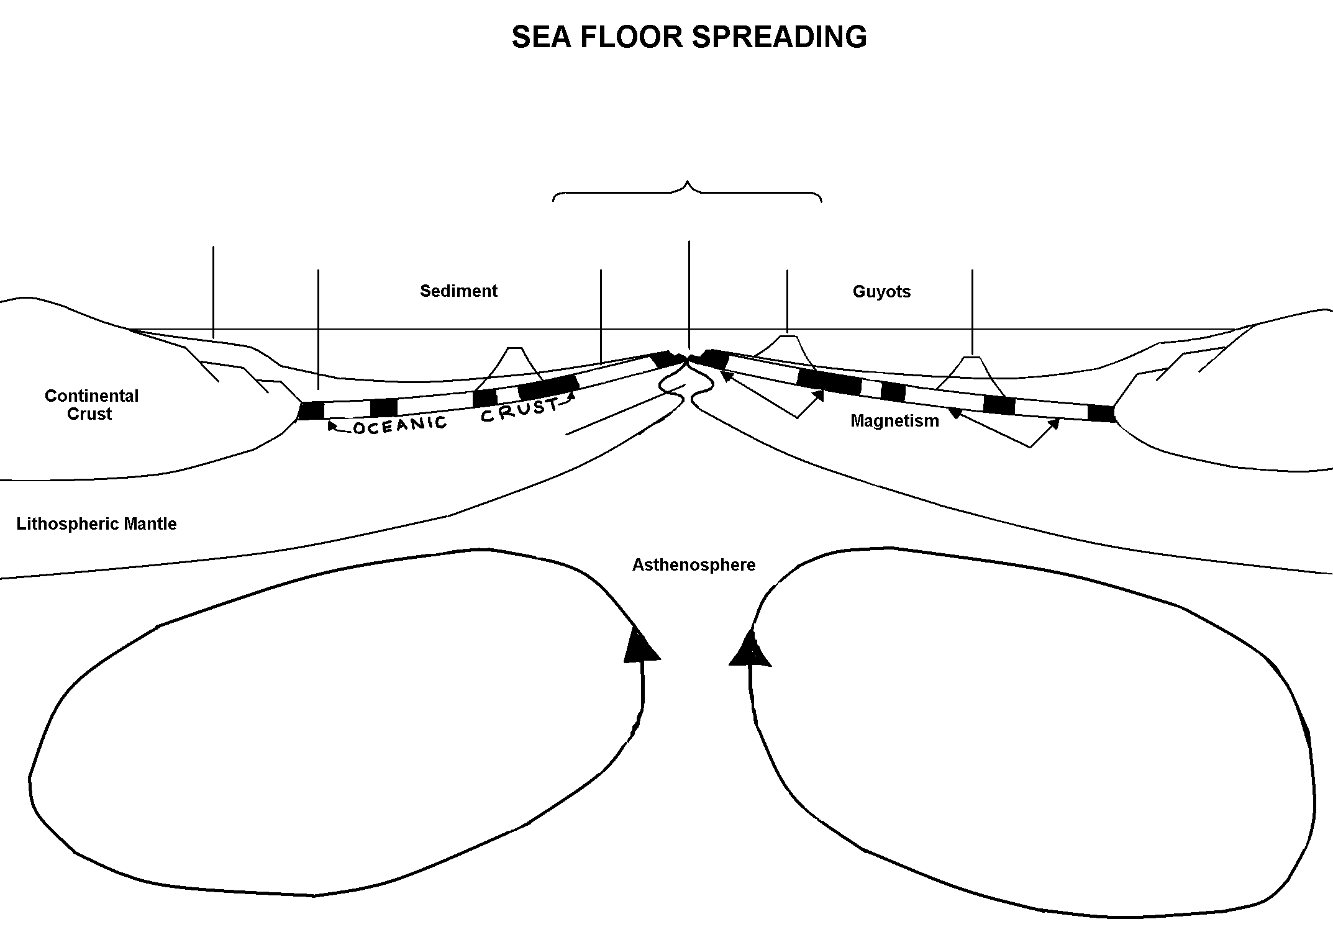
p. 39a in Handout Packet

Slide 40
Mid-Ocean Ridge

Slide 41
Mid-Ocean Ridge
Rift Valley

Slide 42
Mid-Ocean Ridge
Continental Shelf
Rift Valley

Slide 43
Figure 15.3

Slide 44
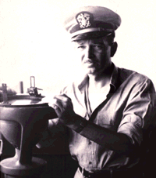
Harry Hess
Mid-Ocean Ridge
Continental Shelf
Rift Valley
shallow
deep

Slide 45
Mid-Ocean Ridge
Continental Shelf
Rift Valley
thick
thin
shallow
deep

Slide 46
Mid-Ocean Ridge
Continental Shelf
Rift Valley
thick
thin
shallow
deep
young
old
old

Slide 47
Figure 15.22

Slide 48
“Vine - Matthews- Morley Hypothesis”
Notes:
To view this animation, click “View” and then “Slide Show” on the top navigation bar.

Slide 49
Figure 15.24
Testing the hypothesis

Slide 50
Figure 15.23

Slide 51
Figure 15.23

Slide 52
Mid-Ocean Ridge
Continental Shelf
Rift Valley
thick
thin
shallow
deep
young
old
old

Slide 53
Mid-Ocean Ridge
Continental Shelf
Rift Valley
thick
thin
shallow
deep
young
old
old
normal
reverse

Slide 54
Mid-Ocean Ridge
Continental Shelf
Rift Valley
thick
thin
shallow
deep
young
old
old
hot
Convection Currents
cold
cold

Slide 55
Mid-Ocean Ridge
Continental Shelf
Rift Valley
thick
thin
shallow
deep
young
old
old
basaltic magma
decompression
hot
Convection Currents
cold
cold

Slide 56
Motion at Plate Boundaries
Notes:
To view this animation, click “View” and then “Slide Show” on the top navigation bar.

Slide 57
Seafloor ages confirm the theory

Slide 58
Figure 15.9 (left)

Slide 59
Figure 15.9 (right)

Slide 60
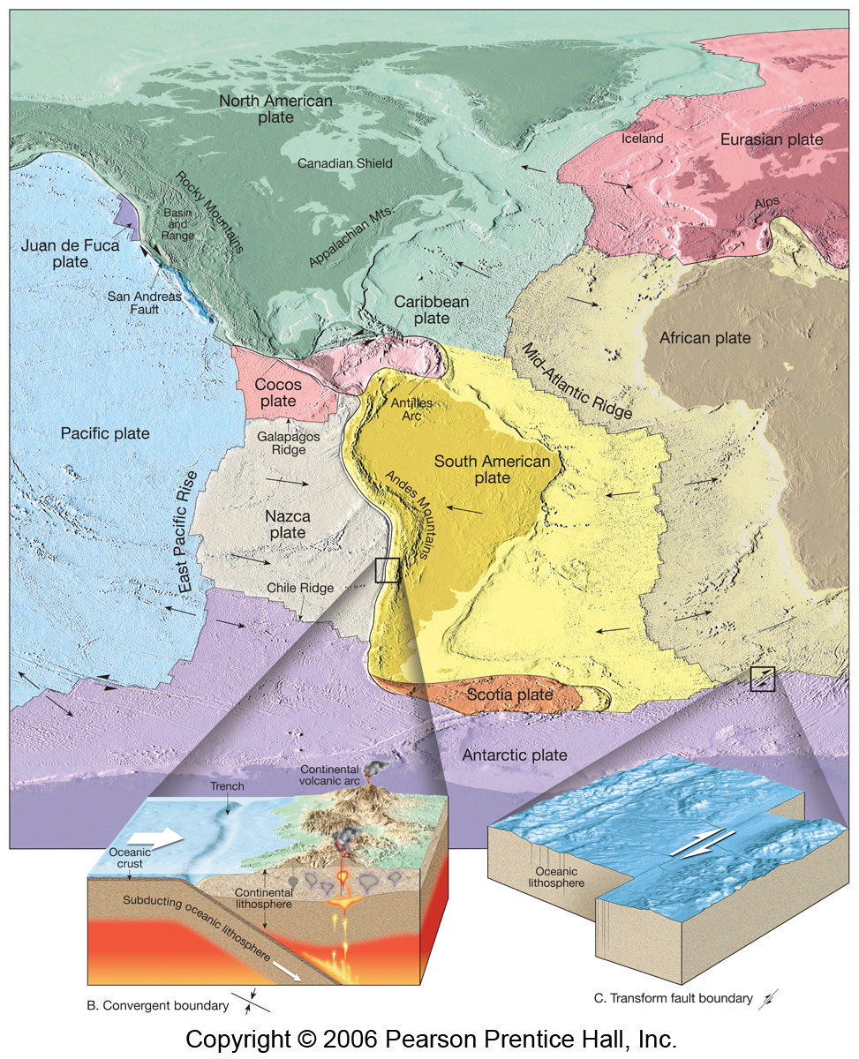
Figure 2.11
~ 12 Lithospheric Plates
(crust + uppermost mantle)
3 Basic Plate Boundaries

Slide 61
Figure 2.12
Divergent
Ocean ←→ Ocean

Slide 62
Figure 2.14
Divergent
Continent ←→ Continent

Slide 63
Figure 2.14 a,b
Hot spot or Thermal bulge

Slide 64
Figure 2.14 a,b
Stretched and thinned crust

Slide 65
Figure 2.14 a,b
Decompression melting forms Basaltic Magma

Slide 66
Figure 2.14 a,b
Rift valley forms in brittle crust by normal faulting

Slide 67
Figure 2.15

Slide 68
Figure 2.14 b,c
Basaltic oceanic crust replaces continental crust

Slide 69
Figure 2.14 c,d

Slide 70
Figure 2.15
Red Sea = linear sea example

Slide 71
Figure 2.14 c,d

Slide 72
Forming a Divergent Boundary
Notes:
To view this animation, click “View” and then “Slide Show” on the top navigation bar.

Slide 73
Figure 15.13
Convergence must compensate for divergence

Slide 74
Figures 2.16
CONVERGENT

Slide 75
Figure 2.16b
Convergence
Ocean → ← Ocean

Slide 76
Figure 11.23
Convergence
Ocean → ← Ocean

Slide 77
Figure 2.16a
Convergence
Ocean → ← Continent

Slide 78
Figure 11.24
Convergence
Ocean → ← Continent

Slide 79
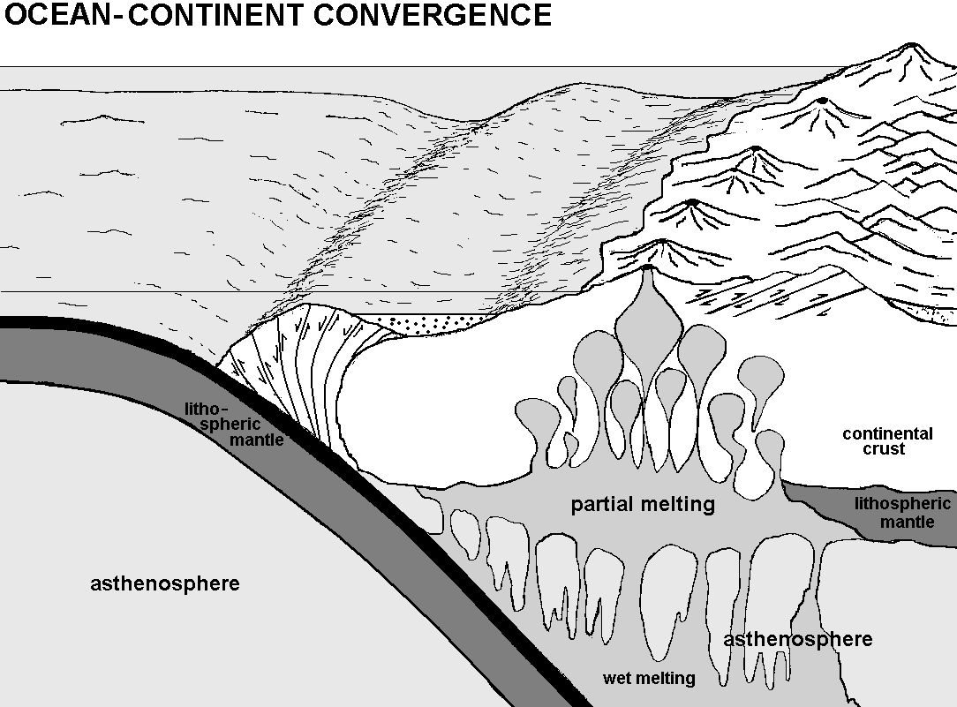
Ocean continent convergence

Slide 80
Ocean continent convergence
T R E N C H

Slide 81
Ocean continent convergence
T R E N C H
SHALLOW TO DEEP EARTHQUAKES

Slide 82
Ocean continent convergence
T R E N C H
H₂O
SHALLOW TO DEEP EARTHQUAKES

Slide 83
Ocean continent convergence
VOLCANIC ARC (andesite)
T R E N C H
SHALLOW TO DEEP EARTHQUAKES

Slide 84
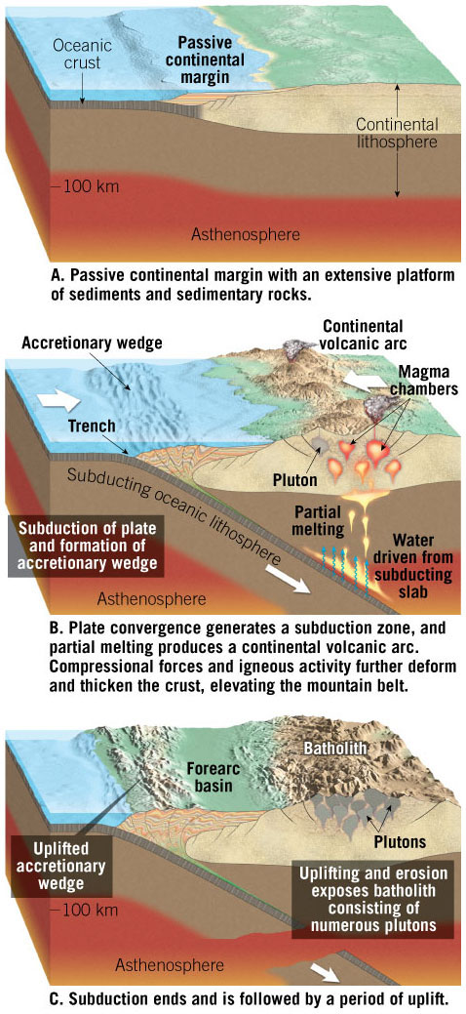
Figure 11.24

Slide 85
Ocean continent convergence
VOLCANIC ARC (andesite)
ACCRETIONARY WEDGE
T R E N C H
SHALLOW TO DEEP EARTHQUAKES

Slide 86
Ocean continent convergence
VOLCANIC ARC (andesite)
ACCRETIONARY WEDGE
T R E N C H
+/- TERRANES
SHALLOW TO DEEP EARTHQUAKES

Slide 87
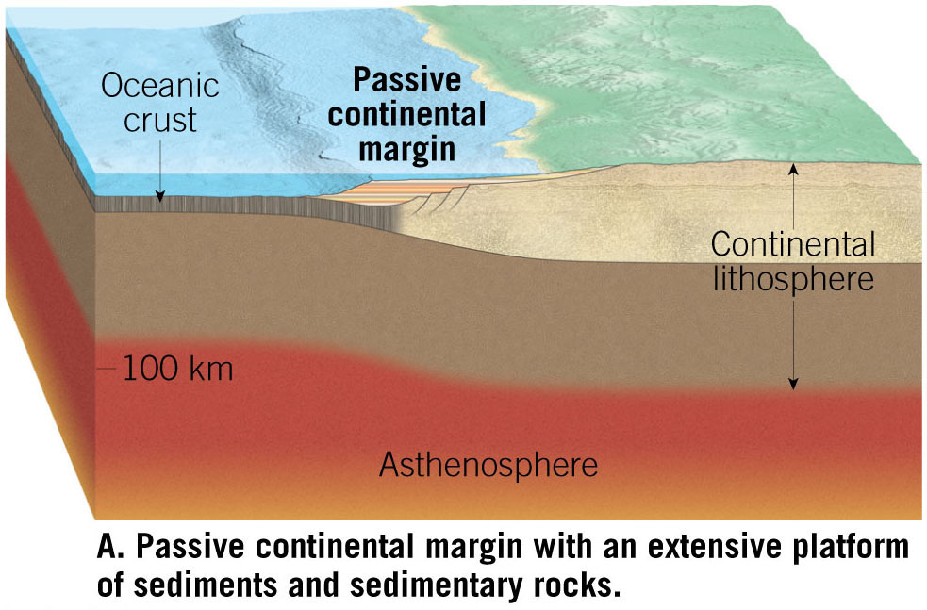
Figure 11.24a

Slide 88
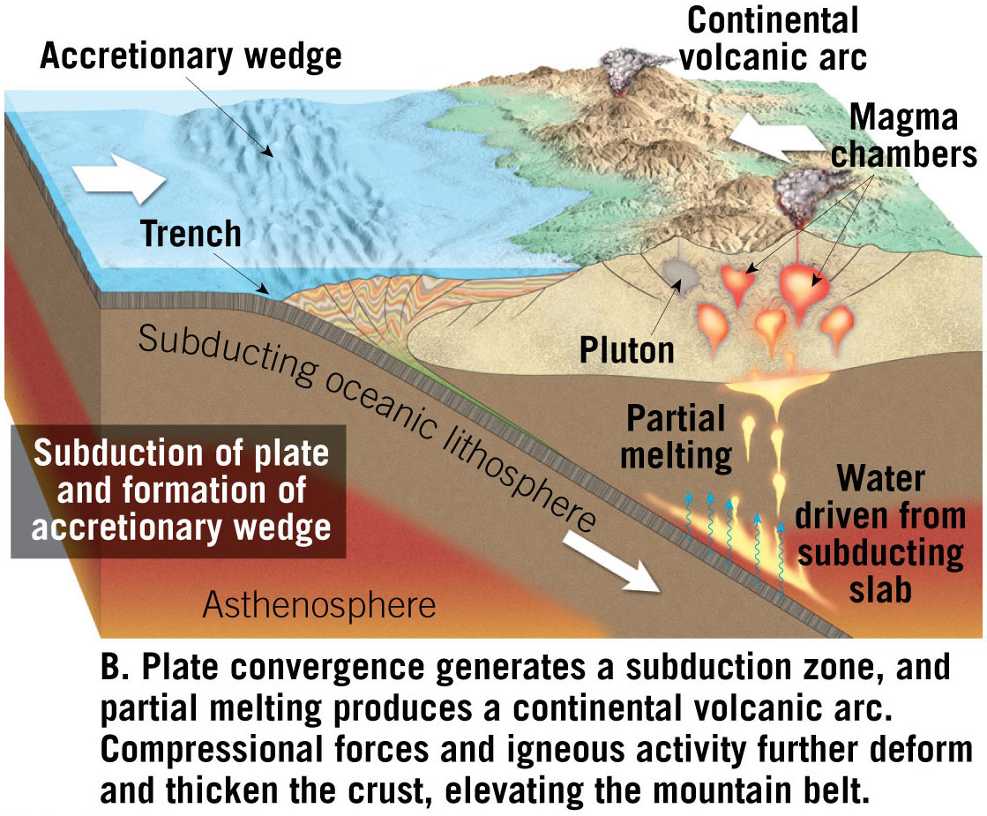
Figure 11.24b

Slide 89
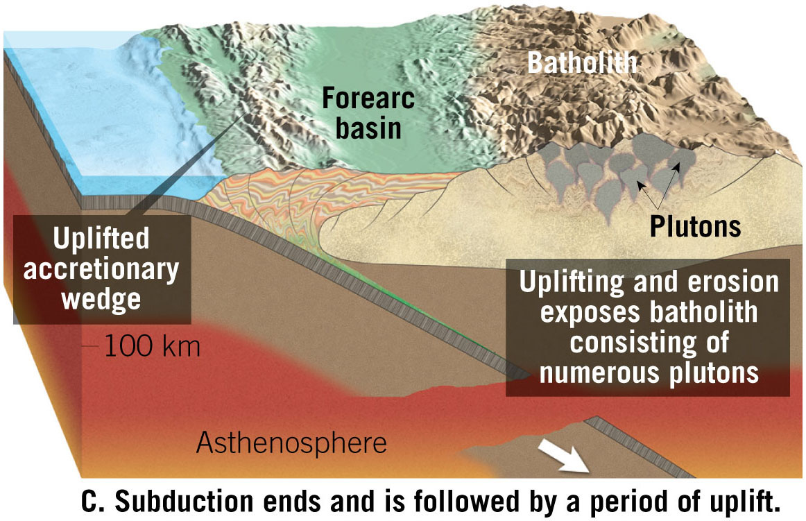
Figure 11.24c

Slide 90
Notes:
Figure 11.25

Slide 91
Figure 11.26
Notes:
Figure 11.26

Slide 92
Figure 11.27
Terranes

Slide 93
Ocean continent convergence
VOLCANIC ARC (andesite)
FOREARC BASIN
ACCRETIONARY WEDGE
T R E N C H
SHALLOW TO DEEP EARTHQUAKES

Slide 95
Ocean continent convergence
VOLCANIC ARC (andesite)
FOREARC BASIN
ACCRETIONARY WEDGE
T R E N C H
ISOSTATIC UPLIFT
SHALLOW TO DEEP EARTHQUAKES

Slide 96
Figure 11.23
ISOSTATIC UPLIFT

Slide 97
Ocean continent convergence
FORELAND FOLD & THRUST BELT
VOLCANIC ARC (andesite)
FOREARC BASIN
ACCRETIONARY WEDGE
T R E N C H
SHALLOW TO DEEP EARTHQUAKES

Slide 99
Ocean continent convergence
FORELAND FOLD & THRUST BELT
VOLCANIC ARC (andesite)
FOREARC BASIN
ACCRETIONARY WEDGE
T R E N C H
FORELANDBASIN
SHALLOW TO DEEP EARTHQUAKES

Slide 101
Figure 2.16c
Convergence
Continent → ← Continent

Slide 102
Convergent Margins: India-Asia Collision
Notes:
To view this animation, click “View” and then “Slide Show” on the top navigation bar.

Slide 103
Figure 11.28
Notes:
Figure 11.28

Slide 104
Figure 11.28a
Notes:
Figure 11.28a

Slide 105
Figure 11.28b
Notes:
Figure 11.28b

Slide 107
Figure
11.30
Notes:
Figure 11.30

Slide 108
11.29 “continental escape”

Slide 109
?

Slide 110
Figure 11.34
Notes:
Figure 11.34

Slide 112
Figure 2.20

Slide 113
Motion at Transform Boundaries
Notes:
To view this animation, click “View” and then “Slide Show” on the top navigation bar.

Slide 115
Figure 2.21

Slide 116
Figure 15.16

Slide 117
Figure 15.19

Slide 118
Convection and Tectonics
Notes:
To view this animation, click “View” and then “Slide Show” on the top navigation bar.

Slide 119
Hot Spot Volcano Tracks
Notes:
To view this animation, click “View” and then “Slide Show” on the top navigation bar.

Slide 120
Figure 2.27

Slide 122
Figure 2.37a

Slide 124
2.36
RIDGE PUSH VS. SLAB PULL

Slide 125
TRENCH ROLLBACK

Slide 126
Chapter 15 Opening Figure

Slide 127
Figure 15.25

Slide 128
Figure 15.26

Slide 129
Figure 15.27

Slide 130
Figure 15.27a

Slide 131
Figure 15.27b

Slide 132
Figure 15.27c

Slide 133
Figure 15.28

Slide 134
Figure 15.A

Slide 135
Figure 15.Aa

Slide 136
Figure 15.Ab

Slide 137
Figure 15.Ac

Slide 138
Figure 15.Ad

Slide 139
Figure 15.Ae

Slide 140
Figure 15.Af

Slide 141
Breakup of Pangaea
Notes:
To view this animation, click “View” and then “Slide Show” on the top navigation bar.

Slide 142
Motion at Plate Boundaries
Notes:
To view this animation, click “View” and then “Slide Show” on the top navigation bar.

Slide 143
Seafloor Spreading and Plate Boundaries
Notes:
To view this animation, click “View” and then “Slide Show” on the top navigation bar.

Slide 144
Chapter 15 Opening Figure

Slide 145
Figure 15.1

Slide 146
Figure 15.2a

Slide 147
Figure 15.2b

Slide 148
Figure 15.7a

Slide 149
Figure 15.7b

Slide 150
Figure 15.20a

Slide 151
Figure 15.20b

Slide 152
Figure 15.24a

Slide 153
Figure 15.24b

Slide 154
Figure 15.10a

Slide 155
Convection in a Lava Lamp
Notes:
To view this animation, click “View” and then “Slide Show” on the top navigation bar.

Slide 156
Convection in a Lava Lamp
Notes:
To view this animation, click “View” and then “Slide Show” on the top navigation bar.

